Slide 1
WQD7005 Data Mining Assignment Title: Petrol Price Prediction
17198048 Law Yoke Kyng

Slide 2

Milestone 3
Connect Hive Server Using Python
Step 1 : Start Hadoop and Hive Server2
Step 2 : Start Anaconda
Step 3 : Connect Hive using python

Slide 3
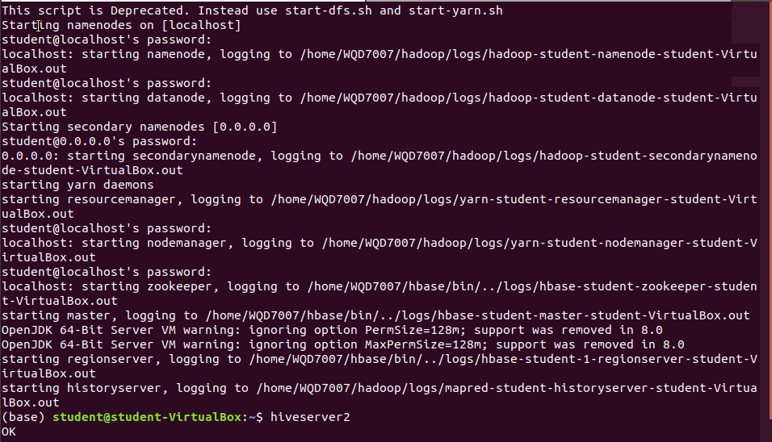
Step 1: Start Hadoop and Hive Server

Slide 4
Step 2: Start Anaconda (Python)

Slide 5
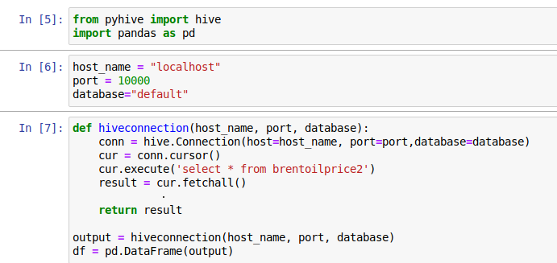
Step 3: Connect Hive using Python

Slide 6
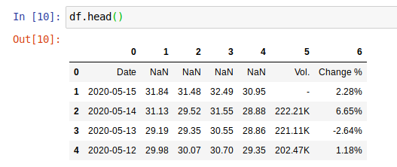
Step 3 : Display data

Slide 7

Thanks for watching and see you again in our next video/ milestone!

